Slide 1





GPT4 Turing Tumble
Ana, Bianca, Issa, Rohit, Talha, Theo

Slide 2

Today’s Agenda
Introduction to the game
Our approach
Challenge Demonstration
AI Models

Slide 3
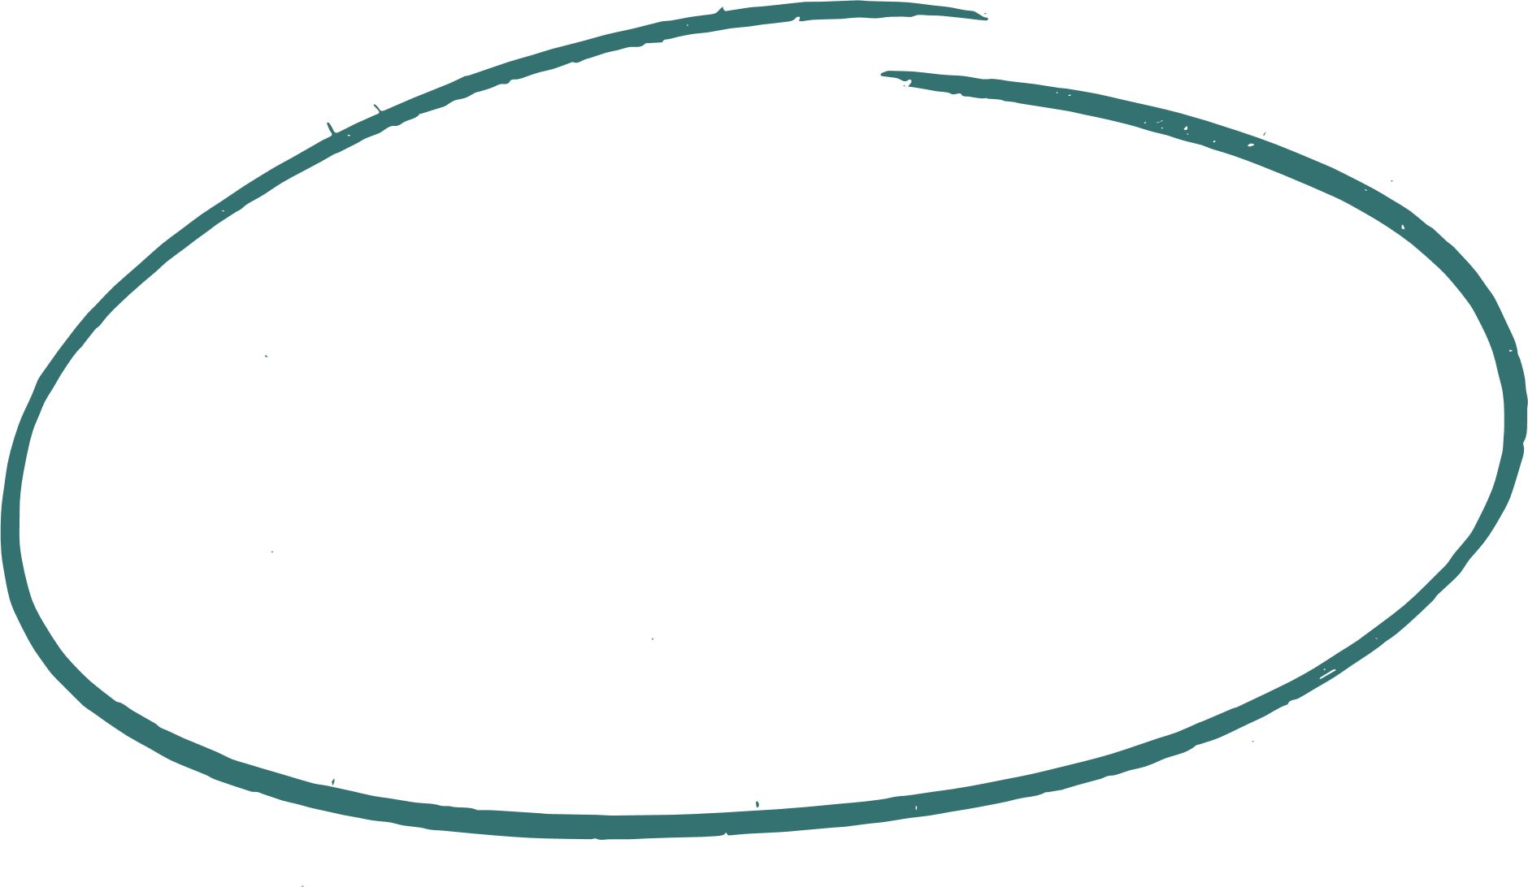

Introduction

Slide 4

What is Turing Tumble?
Mechanical computer game that simulates logic using gravity and marbles
Players build logic circuits on a vertical board using configurable components
Computation is driven by falling marbles
Designed to teach logic, binary, and computer science fundamentals visually
Notes:
Turing Tumble is a mechanical computer game where you solve puzzles by building marble-powered machines.
You use ramps, switches, and gears to guide marbles and perform logic operations, as seen on the board on the left.
You can see how operation are being processed and which parts trigger others.

Slide 5
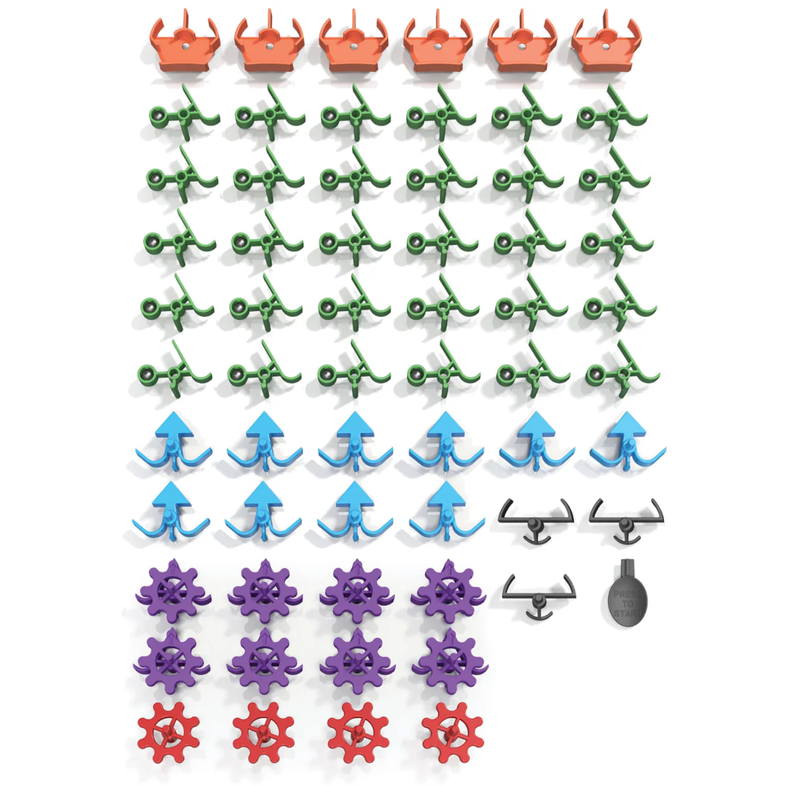
Board Parts
Crossovers: orange, the balls that pass through them keep their direction
Ramps: green, they guide the ball either to the left or right
Bits: blue, store binary state [Left (0) or Right (1)] which is flipped when a marble passes through, the ball gets re-routed in the direction opposite to the current state
Gear Bits: purple, behave just like bits, but can be connected by Gears
Gears: red, allow groups of Gear Bits to share a synchronized state
Interceptors: black, stop balls completely
Notes:
With all of the parts in the game you can build your own circuits on the board or solve the given challenges, which work like small algorithms, where certain parts influence the path the marble takes.
For example, the blue pieces function like an actual bit. They can store binary state, being flipped either to the left or to the right. Another really cool thing is if they are placed vertically on the board they can function as a register and you are able to do operations like subtractions or additions on them.

Slide 6
2. Our approach
Notes:
So how did we manage to implement this all of this into an app? I will give you a short overview of our approach in the next slide.

Slide 7


1
3
Adapt the board game Turing Tumble to a playable game on a web interface
Connect the models to the game and have it work together
2
4
Teach the game and logic to an AI model, which will then help solve challenges
Play alone or with the help of the AI agent
Notes:
The first step we took was implementing the logic for the parts and how they interact with the marbles (in python for better compatibility with the LLMs) and setting up the front-end with React. We implemented presets for the challenges, and the AI subgroup worked in parallel to teach the logic to several AI models.
Afterwards we connected the models to the AI assistant menu in the game, so that in the end you can either solve the challenges yourself or with the help of the agent.

Slide 8
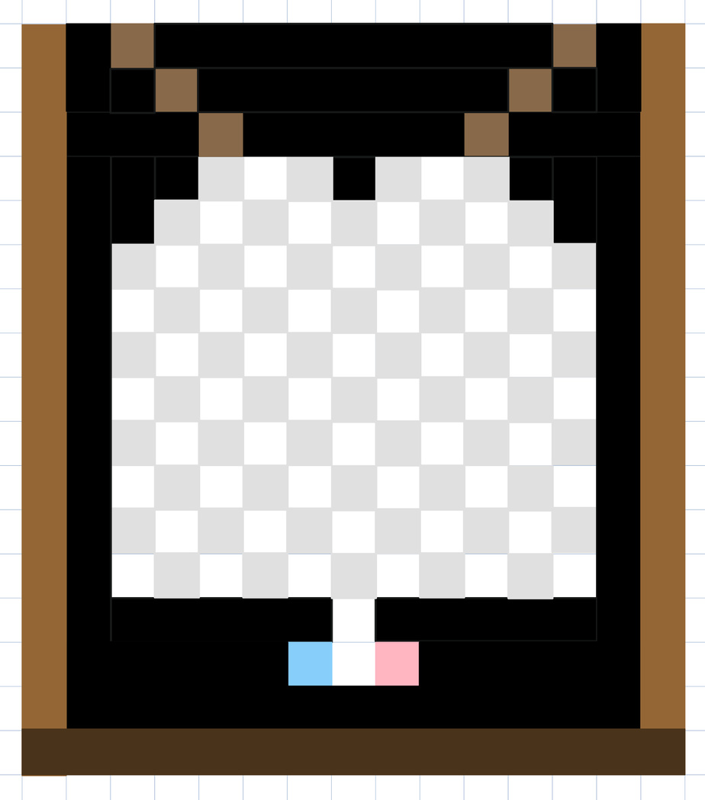
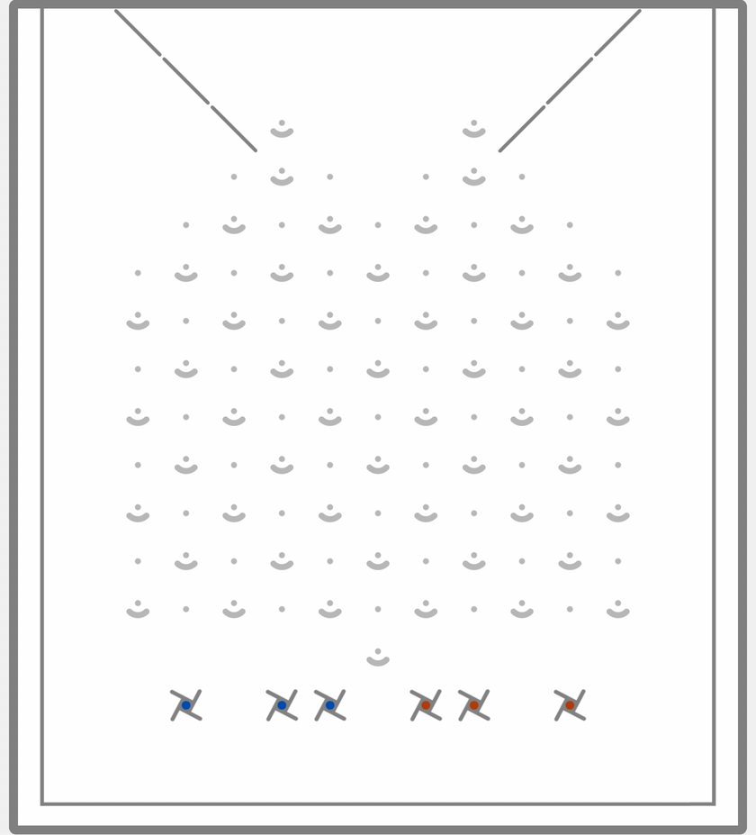
Board Creation Process
Game board abstractified as a 15x17 matrix
Final product
Notes:
We decided it would be easiest to visualize the board as a matrix, so that the coordinates of each placed part would be clear. Here you can see the initial drawing when we first got the idea and the final product. The state of the board is being constantly updated as the pieces are being placed.

Slide 9
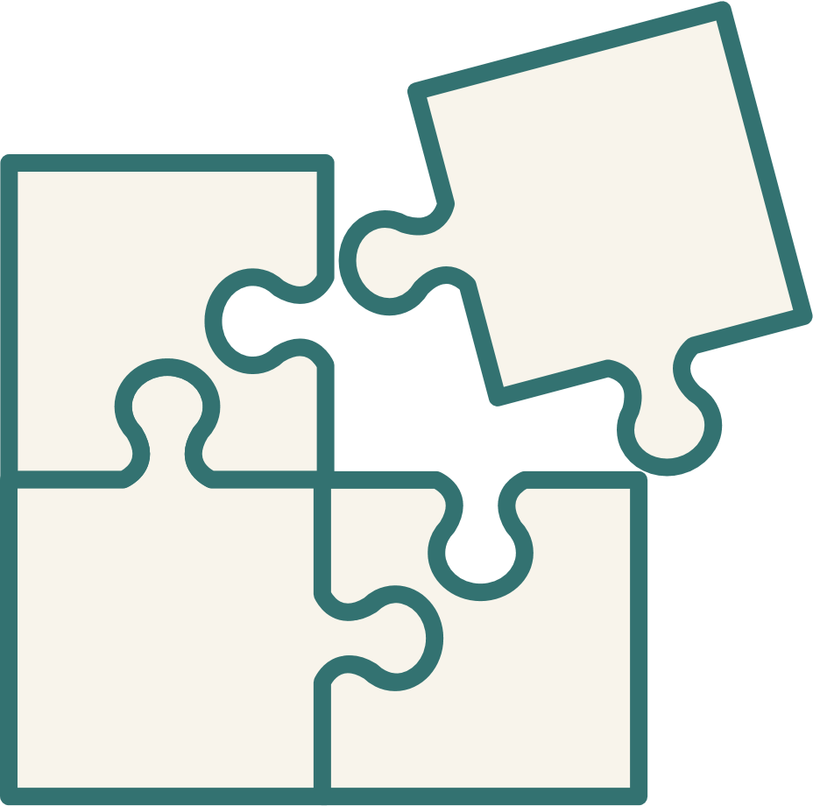
3. Challenge Demonstration

Slide 10
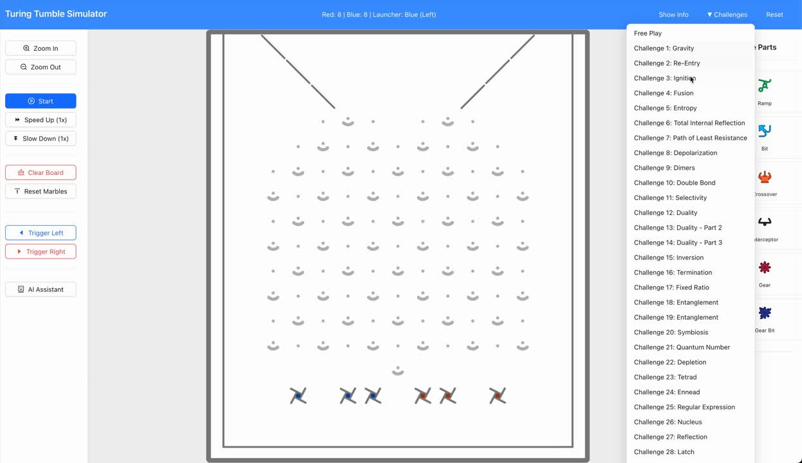

Slide 11
4. AI Models

Slide 12
AI Assistant
We have 3 different AI Models we are testing to see which is best to help solve the ongoing challenge. (LLaMa2, GPT2, VLM)
They are all given a template so the prompt is always the same and we can ensure the answer stays the same and is one we can work with.
The AI model gets the present board state and the ongoing challenge so it can work on solving it.

Slide 13
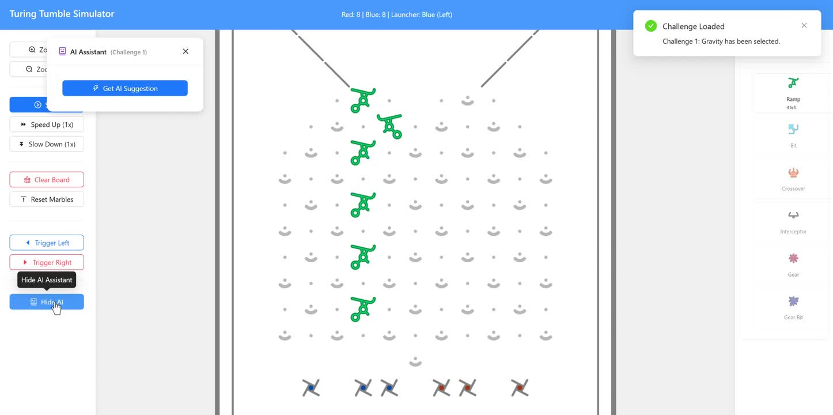
LLaMa2

Slide 14
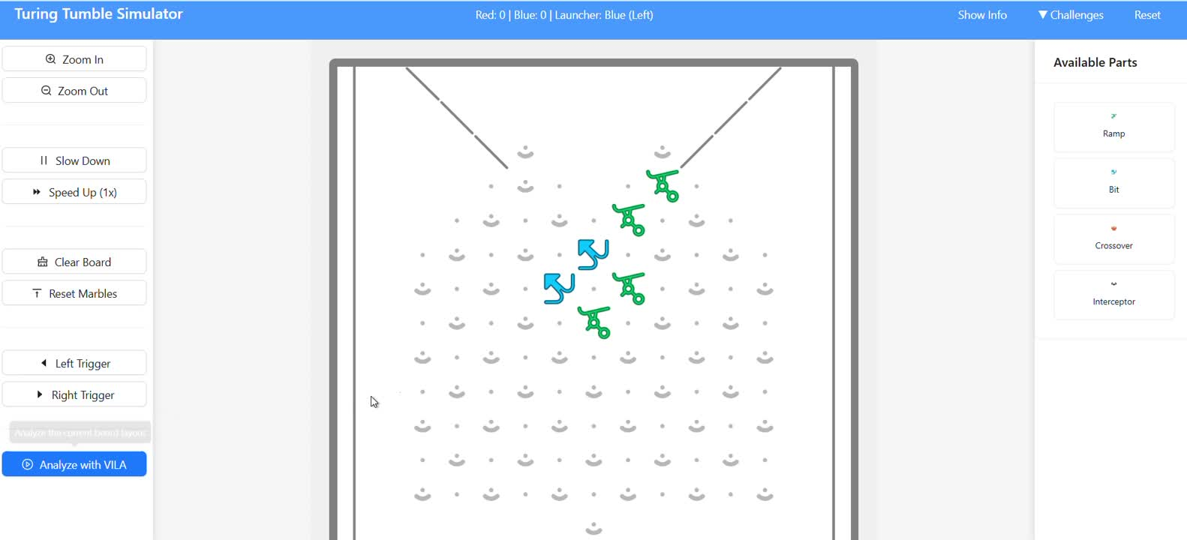
VLM

Slide 15
What’s next?
1
2
3
Refine the template and AI models to get the best possible answer every time it is asked.
Parsing the solution of the AI to the actual board so the user can interact with the proposed result.
Make the game and assistant work fluently together and add finishing touches to the front-end.
Notes:
Turing Tumble is a mechanical computer game where you solve puzzles by building marble-powered machines.
You use ramps, switches, and gears to guide marbles and perform logic operations, as seen on the board on the left.
You can see how operation are being processed and which parts trigger others.

Slide 16

Q&A Session

Slide 17

Thank You For Your Attention!

